Slide 1
Presentation title:
The Renowned 20 religious places of Nepal To visit
Theme: Responsible Tourism
Presented by:
Dilasha Adhikari
Diya Bhattarai

Slide 2
4
Introduction
5, 6, 7, 8, 9, 10, 11, 12, 13, 14
20 renowned religious place
Table of Content
15
Conclusion
16
Q & A

Slide 3
“Putting Tourism on a sustainable path is a major challenge, requiring partnership and co-operation within the tourism industry and between the industry, governments and tourists themselves.”
Klaus Toepfer

Slide 4
Introduction
This is a short report on the topic of “ The renowned 20 religious places of Nepal to Visit”. It briefly introduces the must visiting religious sites of Nepal for the tourists who believe on religion especially Hinduism and Buddhism not only this it also equally support for the people who are eager to learn about these religions.
For this report, we have used mostly the secondary sources which are reliable. Though there were some limitations in our research we finally became able to present this in front of you all.
Nepal, the land of Gautam Buddha and lord Shiva is renowned for its oldest religion. This country has its uniqueness in every aspects taking from its national flag to its diversed climate, topography, flora and fauna. It has a lot of potentiality in tourism if we introduce its culture and tradition , art and architecture to the world.
As it is said that Kathmandu is the city of temples, even in one city we find innumerable temples, monasteries and monuments. By the above sentence we can assume that there are many religious sites in Nepal. But due to out time boundary, we have short listed only 20 religious places which are enlisted below:

Slide 5
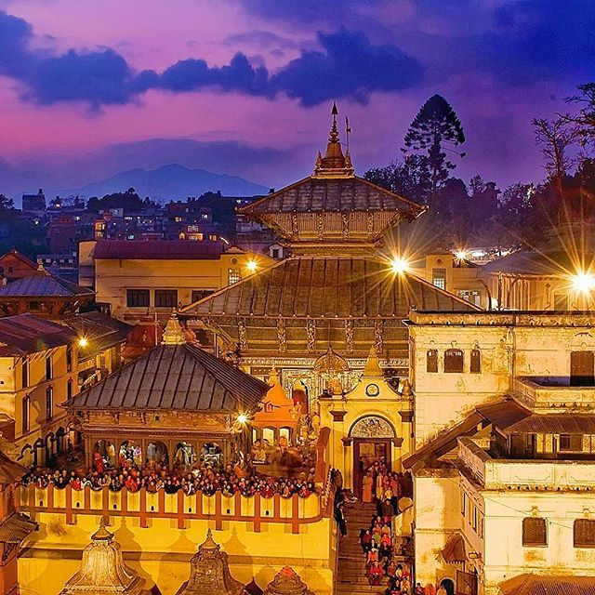
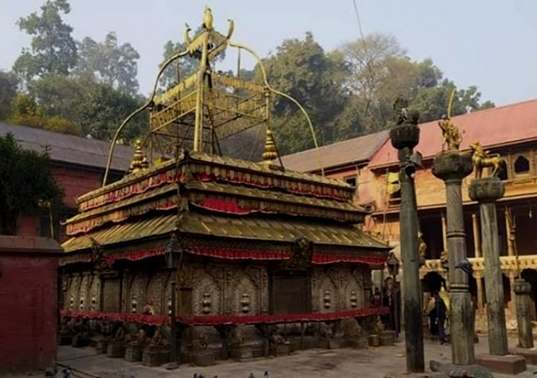
Pashupatinath Temple
Located in Kathmandu, this temple has carried a historical myth in itself. This temple with pagoda style construction attracts thousands of pilgrims internationally every year.
Guhyeshwori Temple
Its another famous temple of Kathmandu is considered a one of the Shakti Peeths.

Slide 6
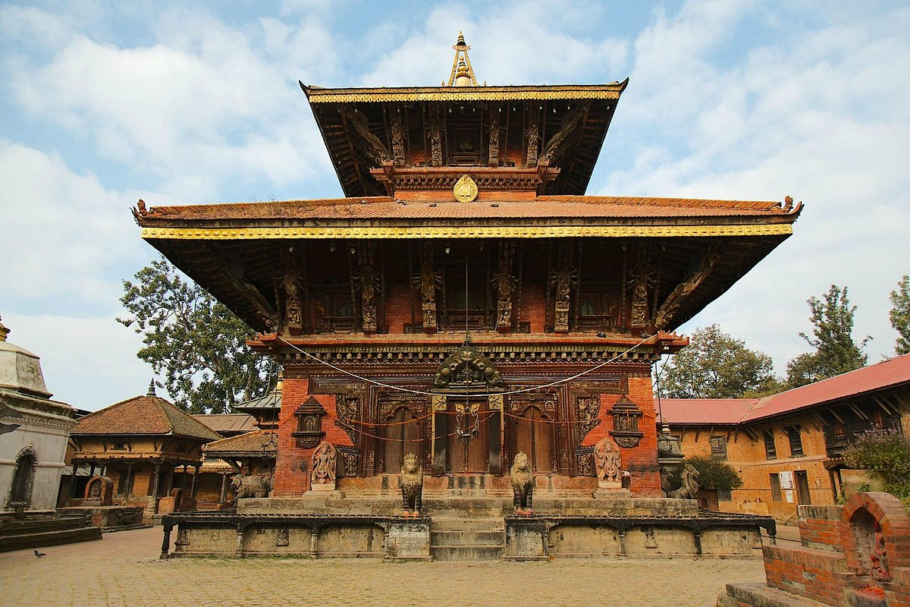
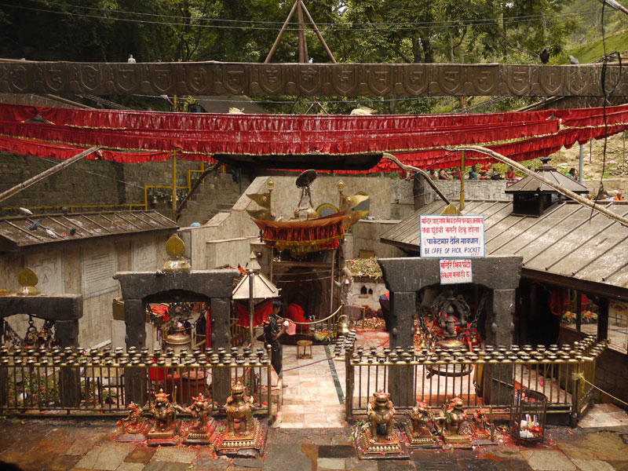
Changu Narayan Temple
This temple of Bhaktapur shows the richness of our country in architect during Lichhabi Dynasty, also considered as golden age of Nepal.
Dakshinkali Temple
Its another temple of kathmandu which is dedicated to the fierce Hindu Goddess ‘Kali’ the incarnation of Devi Parbati.

Slide 7
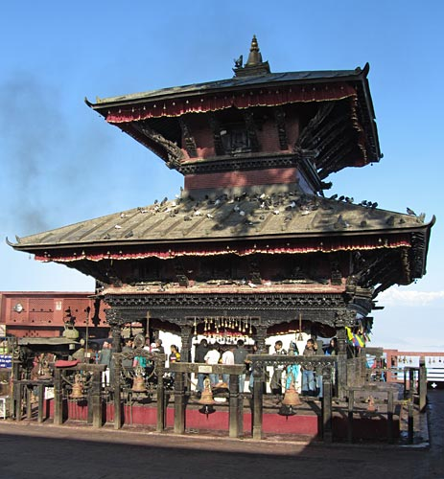
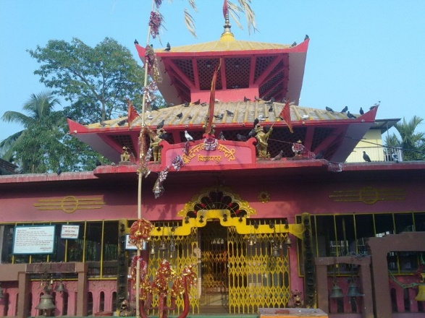
Manakamana Temple
This temple o Gorkha is situated with its stunning architectural beauty and is famous for the fulfillment of our wishes
Dantakali Temple
It’s one of the major Shakti Peeths that is located in Dharan, surrounded by the memerizing Vijaypur hills.

Slide 8
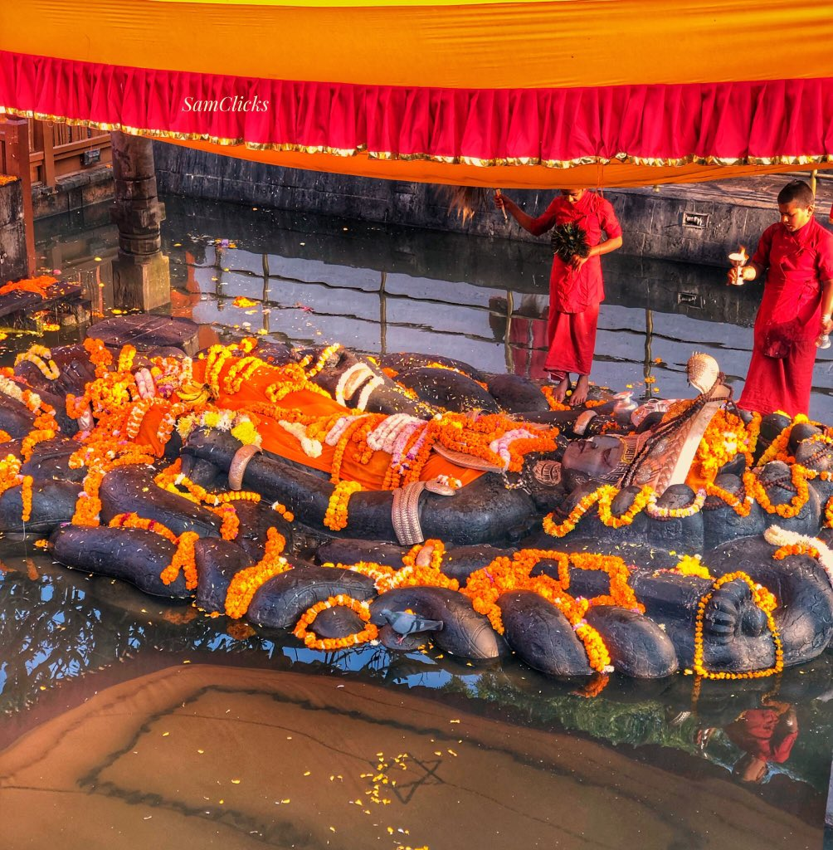
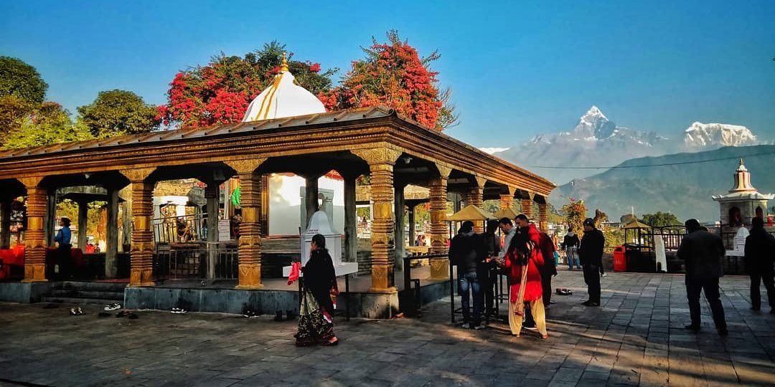
Budhanilkantha Temple
This temple located in Shivapuri hill holds a high religious significance even across the Southern Asia. The biggest stone sculpture of lord Vishnu is very attractive.
Bindabasini Temple
This temple of Pokhara attracts tourists by its lush greenery with gorgeous panorama and breathtaking views.

Slide 9
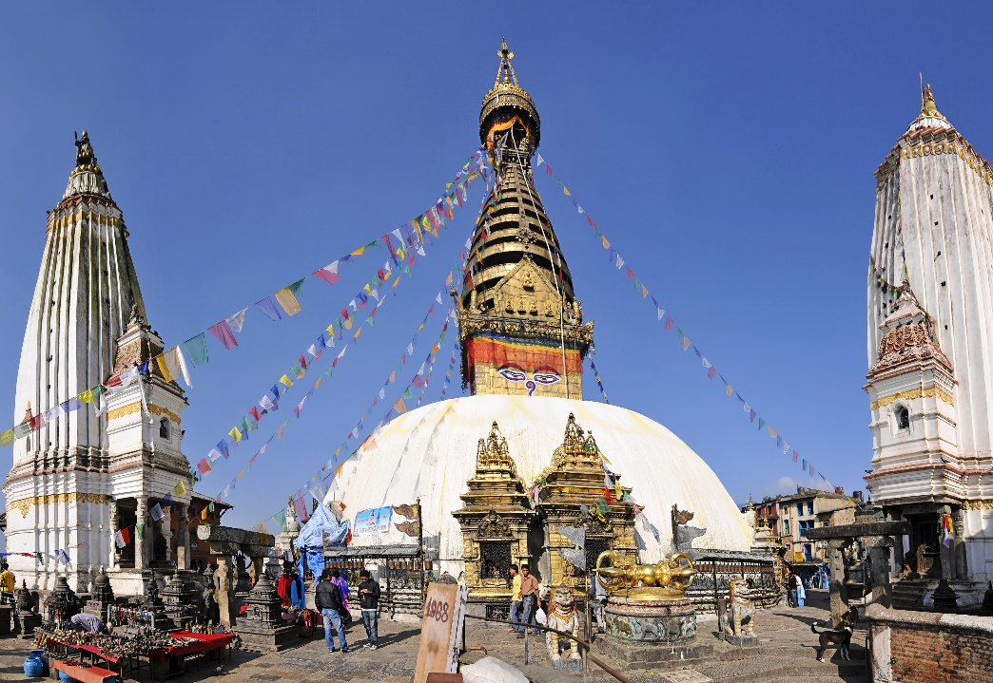
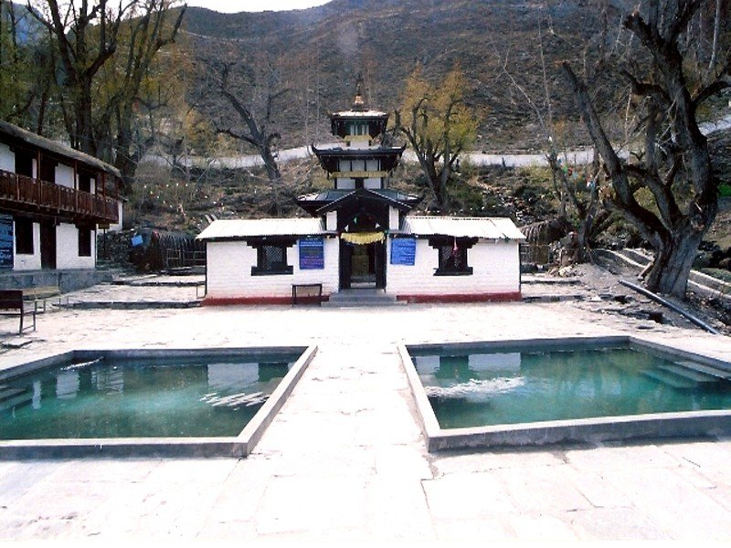
Swayambhunath Stupa
This Stupa is an architectural marvel in the shape of a white dome that signifies our earth. It is one of the oldest and the holiest Buddhist Stupas.
Muktinath temple
Situated on the lap of the snow, this temple of Jomsom is the best place to learn about Tibetan culture and tradition of Nepal.

Slide 10
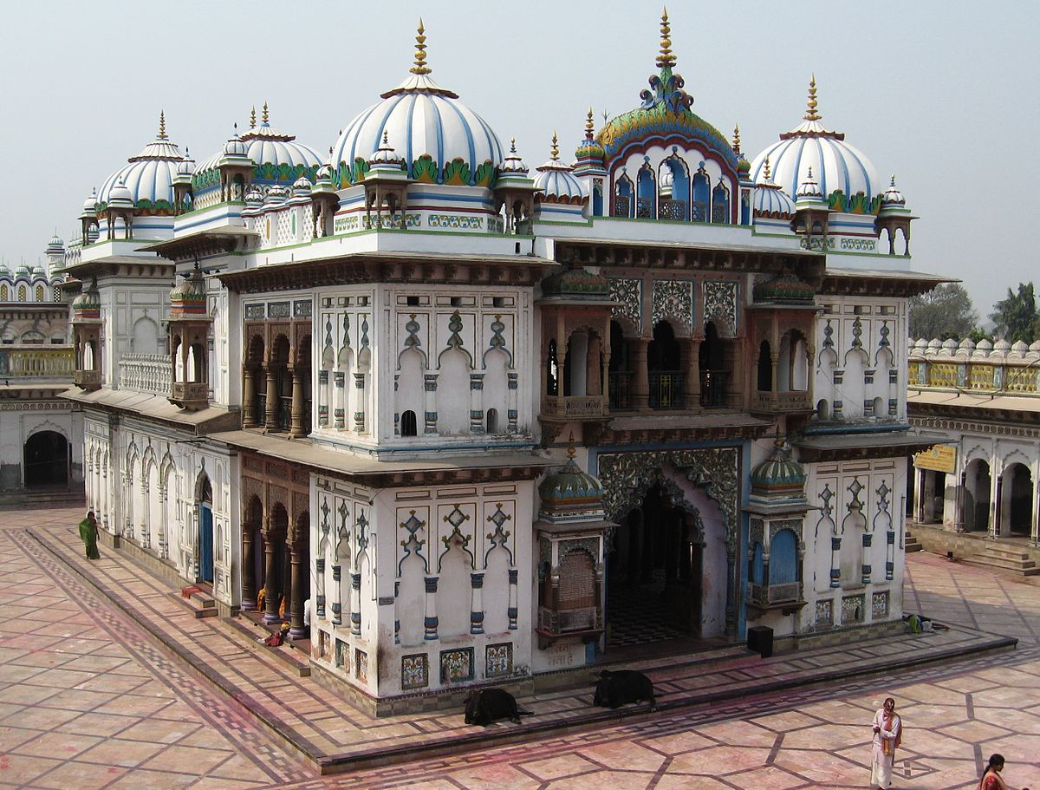
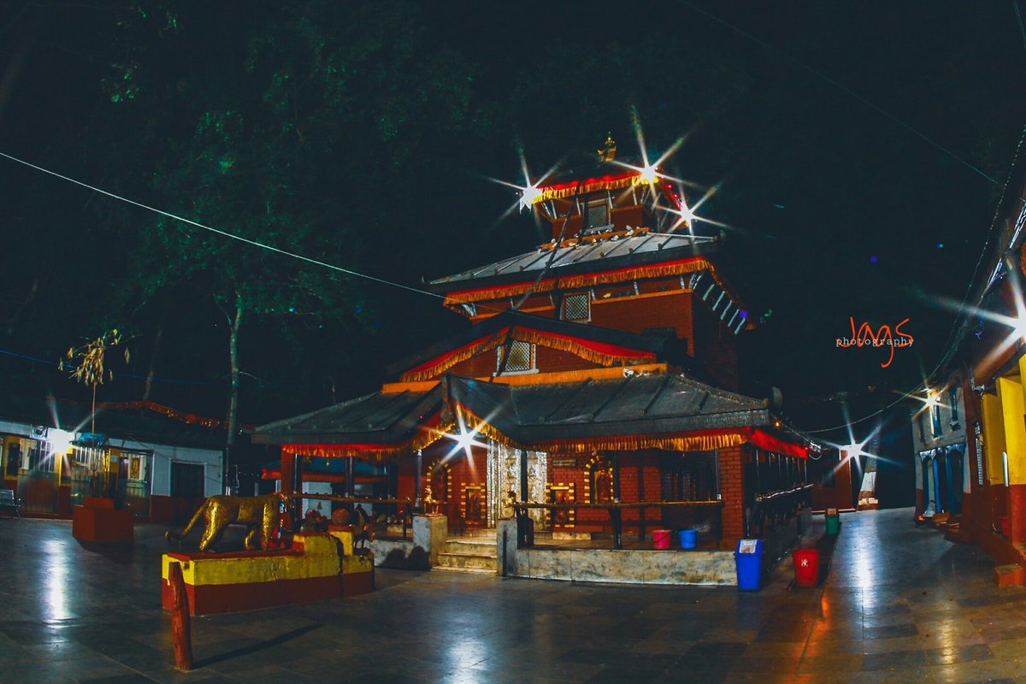
Janaki Temple
This temple of Janakpur attracts tourists by its pretty carvings and beautiful paintings. It is the fusion of Hindu, Koiri and Mugal architecture.
Baglungkalika Temple
This temple located deep inside the forest of Baglung right above the Kali Gandaki river is another ancient temple where Hindus devotees as well as Tantric from different parts of the glove visit the temple to achieve knowledge

Slide 11
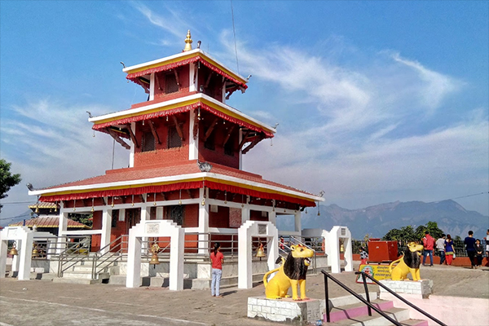
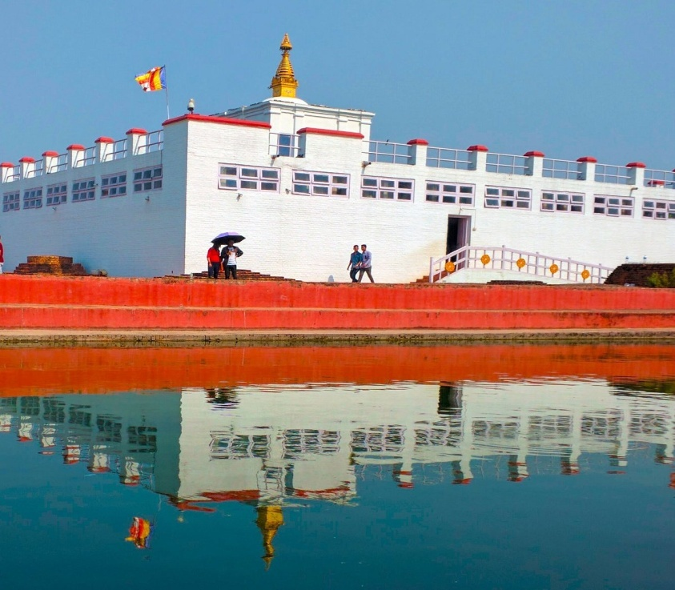
Maulakalika Temple
This temple of Gaindakot, Chitwan is one of the most popular hiking spots for intrapid travelers.
Mayadevi Temple
This is one of the most iconic Buddhist temples situated in the UNESCO declared World Heritage Site of Lumbini. Pilgrims come here to pray, meditate and feel enlightened.

Slide 12
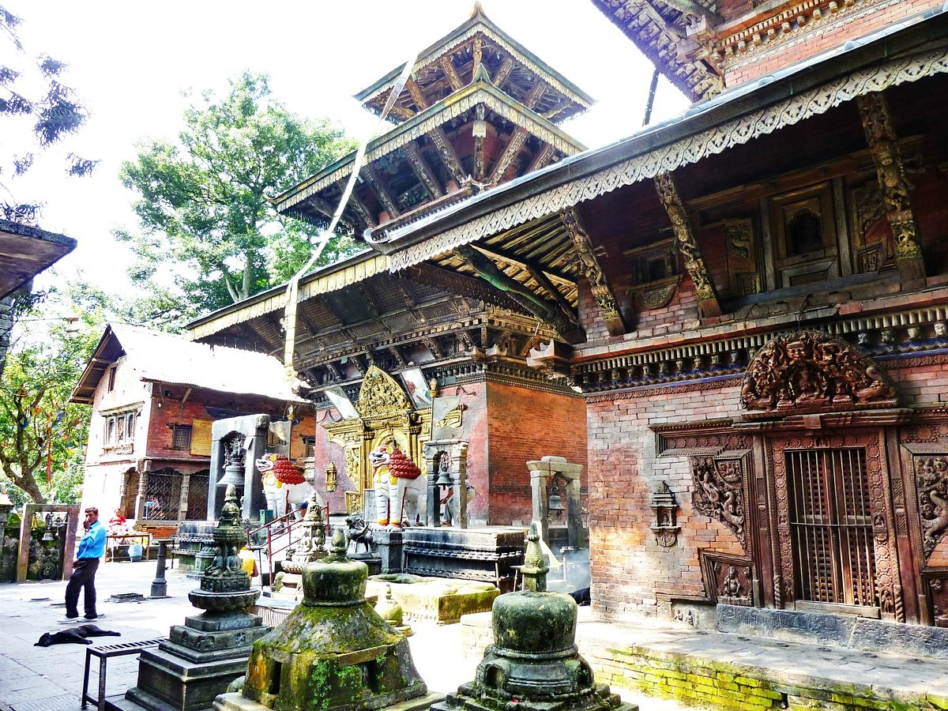
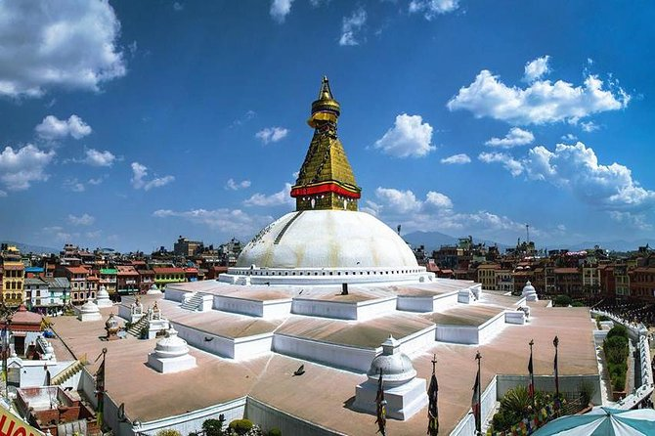
Bajrayogini Temple
This tantric temple of Sankhu is a treasure trove of small temples and caves that looks intriguing and has an old world charm.
Boudhanath Stupa
With countless monasteries enclosing it, this stupa of Kathmandu is the centerpiece of Tibetan Buddhism of Nepal

Slide 13
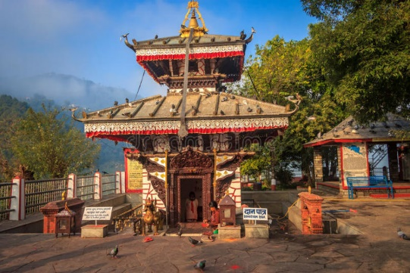
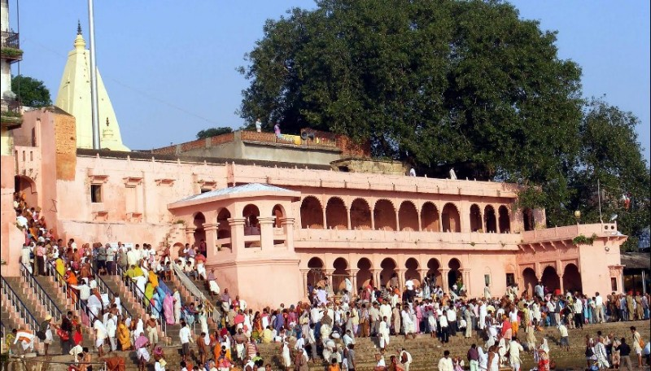
Tal Barahi Temple
Standing in the heart of the Phewa lake, this pagoda style temple holds a significance to both Hindus as well as Buddhist. It is equally suitable for heritage lovers and nature enthusiasts.
Devghat Dham
Located at the confluence of Krishna Gandaki and Seti gandaki rivers in Tanahu, this temple has a historical significance. The great Saligram stone can be found here which doubles its importance.

Slide 14
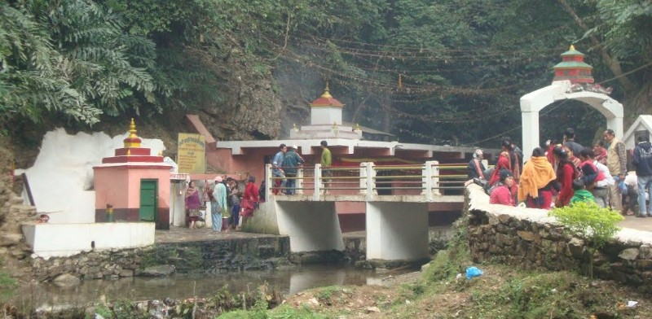
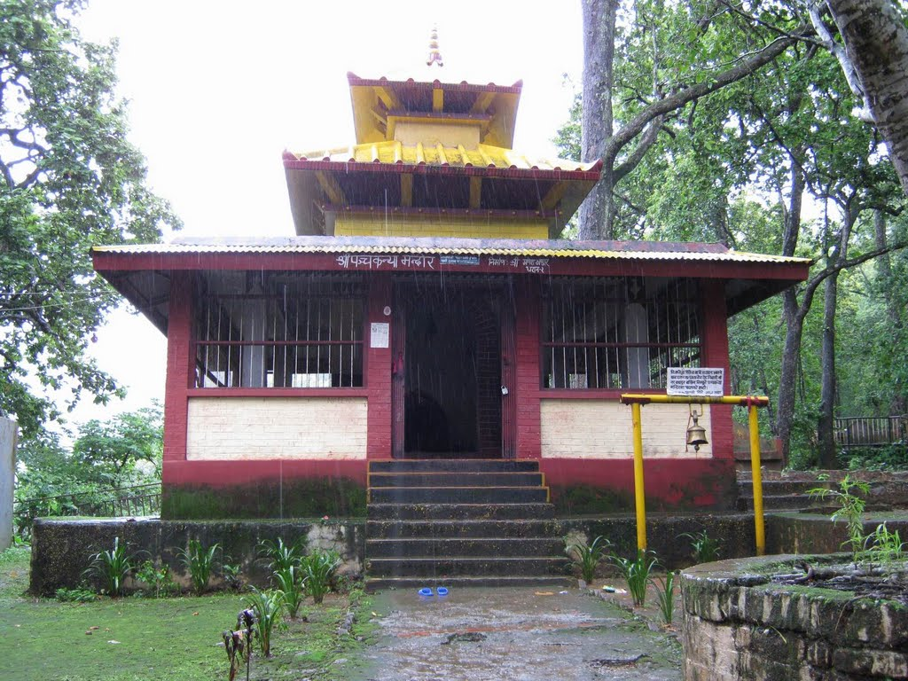
Chhabdi Barahi Temple
This temple of Tanahun district has its own Hindu myth. It is believed that if we visit the temple on foot, all our wishes would be granted.
Panchakanya Temple
This temple is one of the oldest temples in Dharan. As it is in dense forest, we can witness numerous monkeys wandering around. This temple is dedicated to the panchakanyas, the five legendary females.

Slide 15
Conclusion
Within our limited time, we studied on these religious places in detail and found that these places have potentialities of tourism. Many tourists used to visit Nepal every year for different purposes. One is religious purpose too. But due to the pandemic of COVID19, Nepal had lost around millions of tourists. So, there was a very hard time to keep with all the loses for the tourism industries.
On the basis of our brief analysis, we can sum up that Nepak is the best destination for the tourist to spend their holidays. If every local earn how an ancient religious attraction can be brought to life using interactive technology then there is no doubt thousands of visitors come to Nepal from entire globe. But all the citizens must be aware about responsible tourism for the sustainability in the field of tourism. So, that we can proudly say that these heritages are ours, these are our national properties and can show to external tourists for ages and ages.

Slide 16
If you have any question you can ask us and we will give our best to answer it?

Slide 17
Thank you all for
your valuable time.

