Slide 1
A Research Report
On
Tourism Activities One Can Enjoy in
Nepal
Theme: Responsible Tourism
Prepared By:
Balodaya Secondary School/New Galaxy School
Pokhara Nepal
Team members:
Dipen Bikram Bista
Menuka B.K.
Shristi lammichhane
Samjhana Poudel
Barsha Phagami Magar
Submitted to: Director -GTTP Nepal
13th Sept 2022, Kathmandu

Slide 2
Outline:
Acknowledgement
Introduction of Tourism
Responsible Tourism
Tourism Activities One Can Enjoy in Nepal
Current Situation of Tourism in Nepal
Suggestions and Recommendations
Conclusion

Slide 3
Acknowledgement:
Mr. Madan Baral, Director GTTP Nepal
Mr. Saroj Pyakurel Director TRTI Nepal
Mr. Ramesh Kumar Acharya, Founder and In-charge of Balodaya Secondary School

Slide 4
Tourism:
Introduction:
Tourism is the industry related to providing the accommodation facilities to the tourists.
Tourist visit many places in order to find some kind of enjoyment excitement that happen to provide them a break from the boring daily activities of life.
In context of Nepal, we can provide tourists with varieties of many activities that tourists find very thrilling.
History of tourism in Nepal:
Nepal has a long history of tourism since ages ago. The history of tourism in Nepal begins from 1767 till today. There are four main events in the history of tourism in Nepal:
1792- Captain kirk Patric visited Nepal
1860- Sugauli Treaty
1953- Admond Hilary and Tenzing Norgay Sherpa
1998- Establishment of Nepal Tourism Board

Slide 5
Responsible tourism:
Responsible tourism simply means uplifting the standard of a place in terms of service to the tourists (accommodation) and other facilities so that the tourism in that place can be improvised.
Responsible tourism also comprises of bearing the minimal negative economic, environmental and social impacts.
. There are many dimensions that it emphasizes on i.e., cultural diversity, environmental condition, social condition, etc. hence, it also provides tourists with better understanding of cultural heritages for their better experience.

Slide 6
Tourism Activities One Can Enjoy in Nepal:
Mountain Climbing
Paragliding
Rafting
Bungee Jumping
Superman Zipline
Jungle Safari
Trekking
Ultralight aircraft

Slide 7
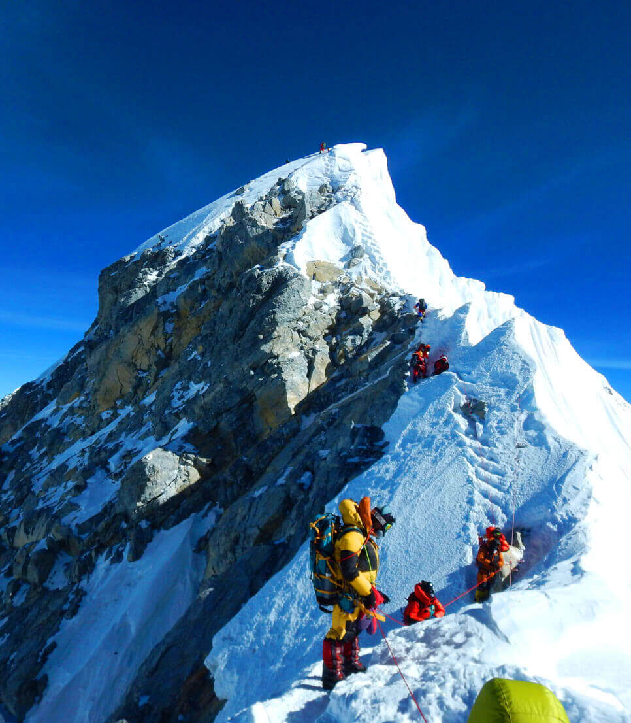
Mountain Climbing:
Mountain climbing is an adventurous activity which provides people with the thrill that they initially ventured out for in their holidays which cannot be felt or experienced in their daily life. They get a chance to be closer to the Mother Nature in the mountains.
Nepal has the world’s tallest peak in the world.
Among the 10 tallest mountains in the world, Nepal consists of 8 of them.

Slide 8
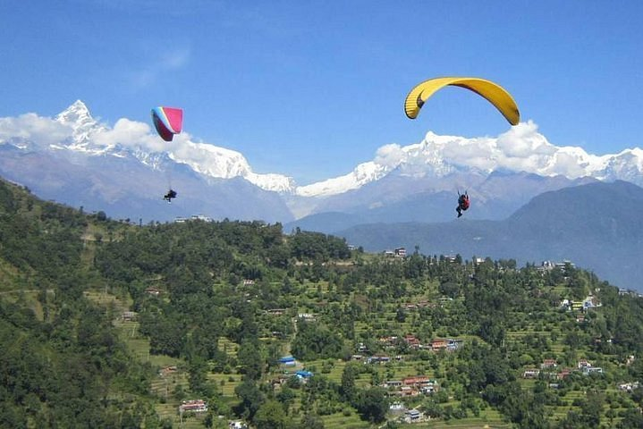
Paragliding:
Paragliding is a recreational and competitive adventurous sport of flying paragliders.
There are other many paragliding spots in Nepal but we have included of the most famous place among them i.e. Pokhara.
A person can enjoy the scenic view of the Pokhara valley.
They can gaze the lake Phewa from above it while enjoying their time in the sky with other tourists and the locals from Sarangkot.

Slide 9
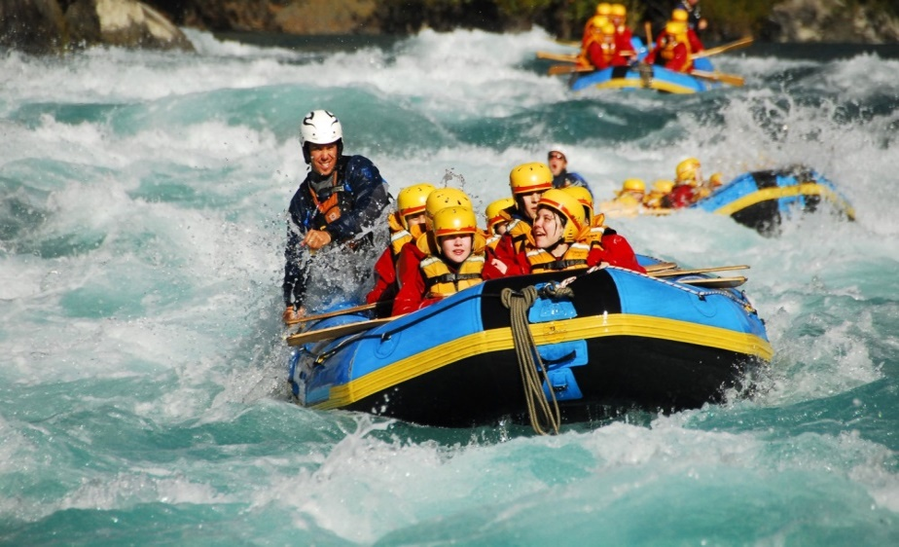
Rafting:
Rafting is recreational outdoor activity in which inflatable rafts are used to navigate fast flowing rivers.
There are many fast-flowing rivers in Nepal where rafting is possible. Some of them are:
Karnali River
Upper Seti River
Sun Kosi River
Marshyandi River
Tamur River
Trishuli River

Slide 10
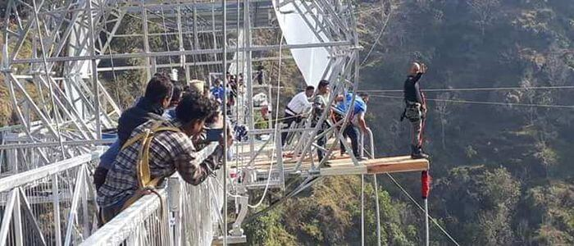
Bungee Jumping:
Bungee jumping is an activity that involves a person jumping from a great height while connected to a large elastic cord.
Nepal has the deepest george for bungee jumping i.e. Kushma.

Slide 11
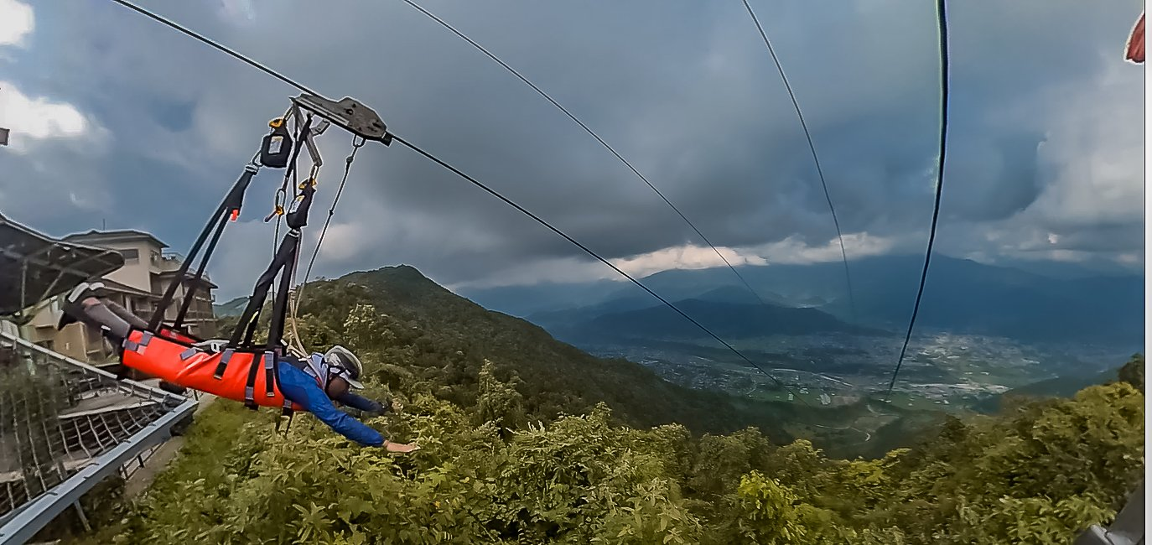
Superman Zipline:
Superman Zipline is different from the classical zip line as it is done in a superman position.
The upper station of the Superman Zipline is in Sarangkot at the height of 1550 meters above sea level and the lower station is at Hemja.
It is also the fastest zipline in the world.

Slide 12
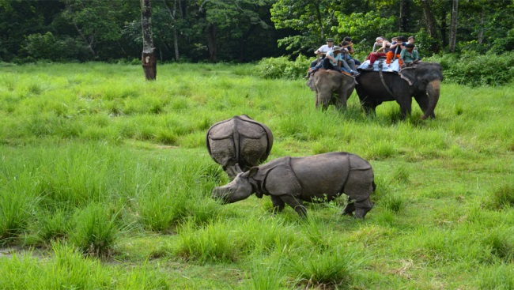
Jungle Safari:
Jungle safari simply means exploring the jungle in order to explore the unexplored trails while also enjoying the wildlife found in the jungle.
In Nepal jungle safari can be done in various national parks and chitwan national park is one of them.
Rare one horned rhinoceros can be observed in this national park.
Elephant riding also can be done.

Slide 13
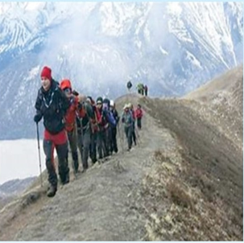
Trekking:
Trekking means walking for days for the purpose of exploring the areas and enjoy the nature.
There are many popular treks in Nepal. Some of them are:
Everest Base Camp Trek
Annapurna Base Camp Trek
Manaslu Circuit Trek
Ghorepani Poon Hill trek

Slide 14
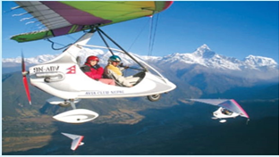
Ultralight aircraft:
Ultralight aircraft take off from Pokhara and offer spectacular views of the lakes, mountains, and villages.
It provides tourists with heaven like view of Pokhara valley.
Tourists also can see mountains from very near.

Slide 15
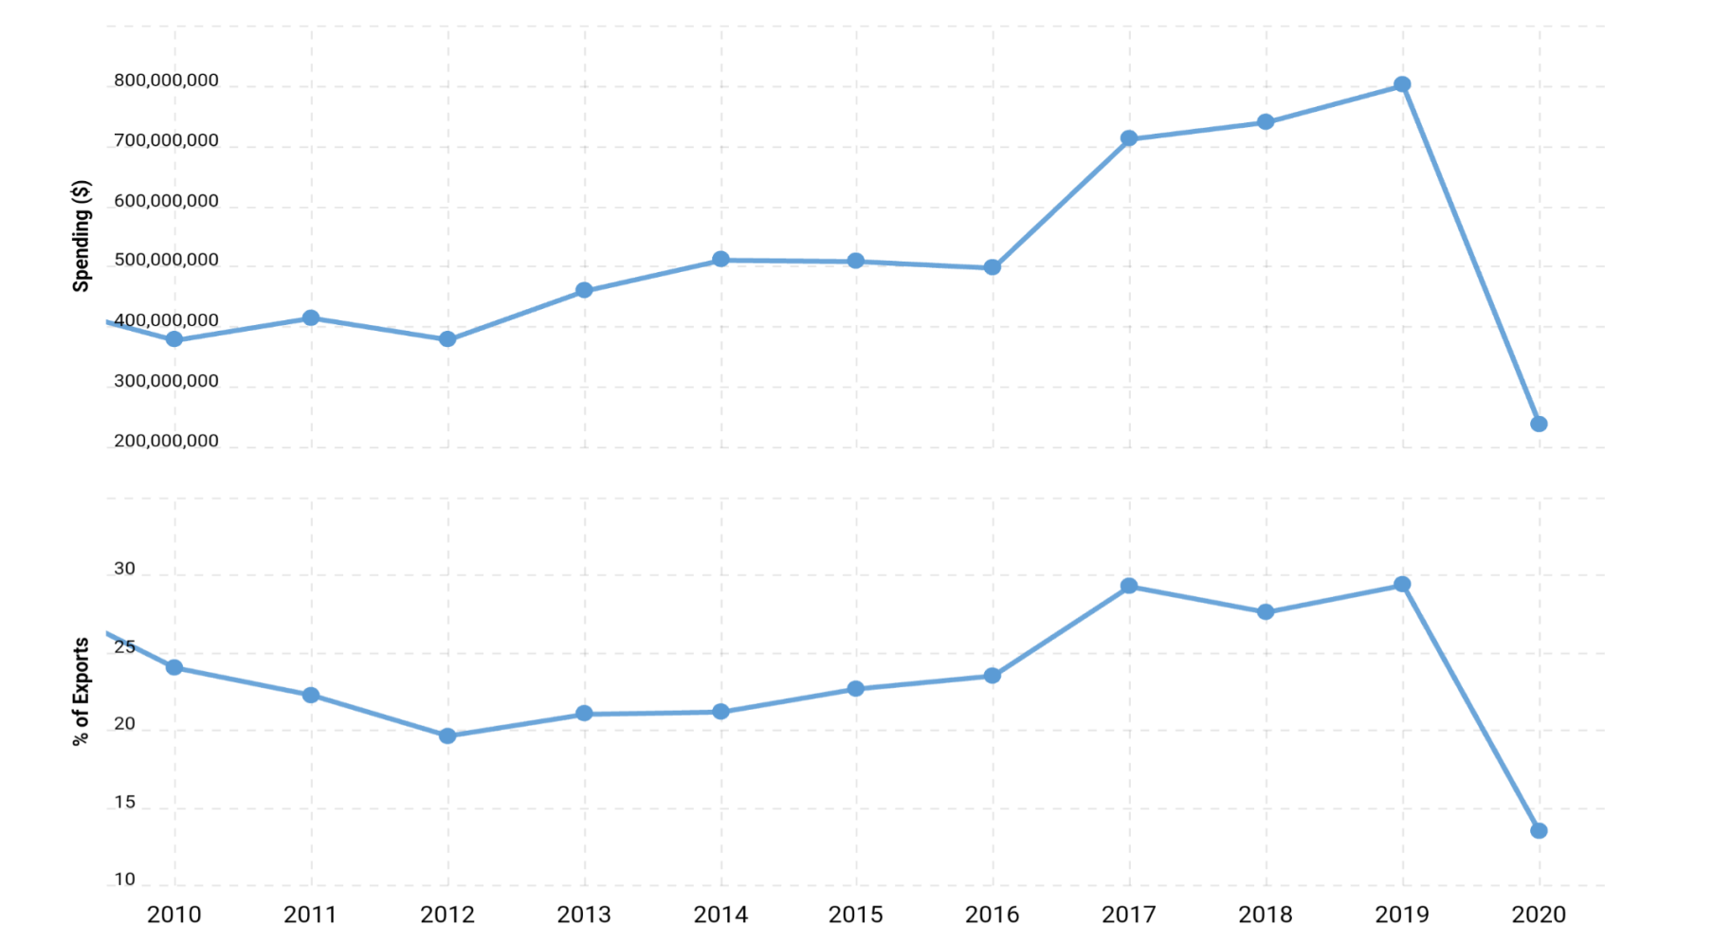
Current Situation of Toursim in Nepal:
Source: Macrotrends.net
Nowadays due to COVID situation, the tourism industry has adversely been affected. The number of the yearly visiting tourists in Nepal decreased by 80 percentage in 2020. Even in the streets of Pokhara Lakeside which used to be full if tourists, there are very less tourists found in the streets.

Slide 16
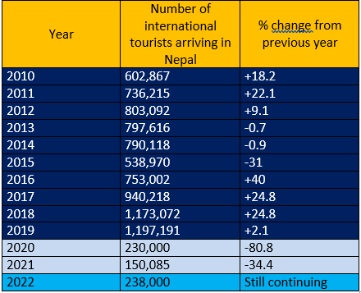
The above table includes the data showing the number of tourists arriving in Nepal yearly. It shows the adverse effect of how the COVID situation in year 2020. the tourists drastically decreased by 80% in year 2020.

Slide 17
Suggestions and Recommendations:-
Competitive events where tourists and locals can participate must be held.
Better accommodation facilities and quality hospitality must be provided to the tourists.
Cleanliness shall be done and hygienic environment shall be maintained.
Mega projects like Visit Year 2020 should be launched again.
Government must run language classes of different languages for the stake holders of tourism.
Tourist map must be displayed in various places to provide the information about the routes of visits.
Eco Tourism and responsible tourism should be promoted by oraganizing different eco friendly packages.

Slide 18
Conclusion:
There are endless possibilities to extend the tourism industries in Nepal. Nepal Tourism Board has run various programs to promote it. Most of the programs are conducted by emphasizing on travel and tourism related people/organizations only but in our point of view such programs will be more successful if publics are also included in it. Though the COVID situation dragged us down in the development of tourism but let’s hope that our country will rise again in the field of tourism and soar the new heights beyond the boundary that our country has ever reached.

Slide 19
Thank you!!!

