Slide 1
The Trending Seven Places of Nepal with Massive Tourist Flow
Theme: Responsible Tourism
Presented by:
Numa Limbu and Aarpana Bhandari (Grade 10)
New Horizon Academy
Chandragiri-9, Machhegaun
16 September, 2022

Slide 2
Introduction
According to the United Nations World Tourism Organization (UNWTO), tourism entails the movement of people to countries or places outside their usual environment for personal or business/professional purposes.
According to the World Travel and Tourism Council (WTTC, 2019), the tourism sector accounted for 10.4 percent of global GDP and 319 million jobs to 10 percent of total employment.

Slide 3
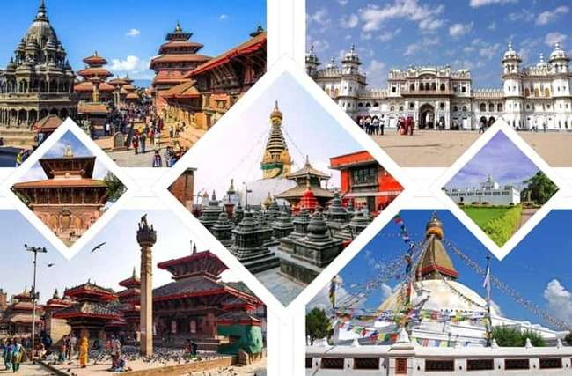
Nepal with its historic importance, rich in cultural heritage and unique nature is an attractive, scenic and safe tourist destination in the world.
The scope of tourism in Nepal extends from the east to the west, from the north to the south, from the air and to the land.

Slide 4
History of Tourism in Nepal
Dates | Events
1951 AD | Establishment of democracy (Nepal became popular tourist destination since 1951)
29th May, 1953 | First ever successful ascent of Mount Everest. Global attention towards Nepal
1955 | Nepal started issuing tourist visa.
1958 | Nepal Airlines started the flight.
1998 | Nepal celebrated “Visit Nepal 98”
2020 | Nepal announced the year as Visit Nepal 2020, but cancelled due to covid 19

Slide 5
Responsible Tourism
In 2020, due to the Covid-19 pandemic the total arrivals of tourists was limited to 230,085 which was 81.0 percent less than that of the corresponding period of the previous year.
The tourism industry in the country has recovered by almost 75 percent as compared to the time prior to COVID-19 outbreak and has witnessed a positive growth in tourist arrival.
By learning lessons from the past, Nepal’s tourism industry can determine a different path for itself in a post–COVID-19 world. For that to occur, governments at all levels must work with the private sector and local communities to devise plans and practices.
At the local level, citizens must be encouraged to adopt sustainable behavior and practices in their daily routines.

Slide 6
Current scenario of tourism in Nepal
In Nepal, the travel and tourism sector contribute to 8 percent of GDP, 6.7 percent of total employment, and it generates 6 percent of the total foreign exchange earnings.
Nepal Tourism Board estimates that loss of 85.2 billion USD monthly from tourism sector only and three in five employees lost their jobs due to COVID-19 in Nepal.
During the period of January 2020 to January 2021 (2020), a total of Rs. 24.9559 billion was earned from foreign tourists visiting Nepal for various purposes. In 2020, the average stay of a tourist was 15.1 days and per day per tourist expense was 65 US dollar.
In terms of the total number of tourist arrivals by country, the five countries with highest number of tourists in 2020 were from India 17.5 percent, Myanmar 9.1 percent, Thailand 9.0 percent, China 8.4 percent and the USA 7.7 percent, respectively. By land route 20.4 percent (excluding Indians) tourists have visited Nepal.

Slide 7
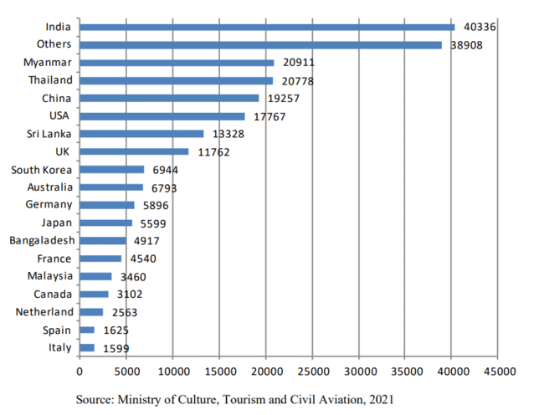
The total number of tourist arrivals by country

Slide 8
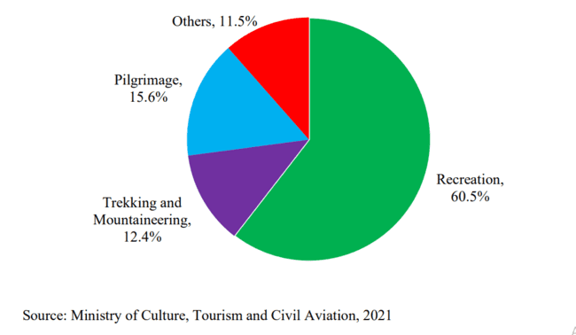
Purposes of Tourists Visiting Nepal

Slide 9
Current scenario of tourism in Nepal
Referring to the data from the Department of Immigration, From January 1 to August 31, 2022, as many as 326,667 foreign tourists visited Nepal. The number of foreign tourists visiting Nepal has significantly increased in the past eight months as Covid-related travel restrictions are gradually being removed.
Months | January | February | March | April | May | June | July | August
No. of tourists | 16,975 | 19,766 | 42,006 | 61,589 | 53,608 | 46,957 | 44,462 | 41,304

Slide 10
Prospects of Tourism in Nepal
Cultural/Festival Tourism
Pilgrimage/Spiritual Tourism
Village Tourism
City Tourism
Mountain Tourism
Nature Tourism
Adventure Tourism
Sport Tourism
Agricultural Tourism
Hospitality Tourism

Slide 11
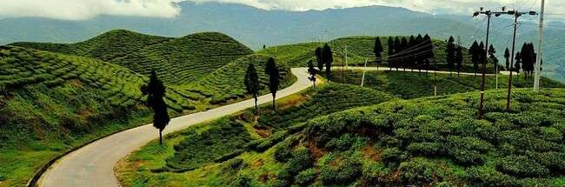
Illam: The Queen of Hills
Province number 1
Eastern Nepal
Area:1,703 km square

Slide 12
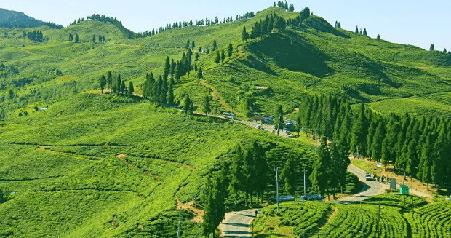
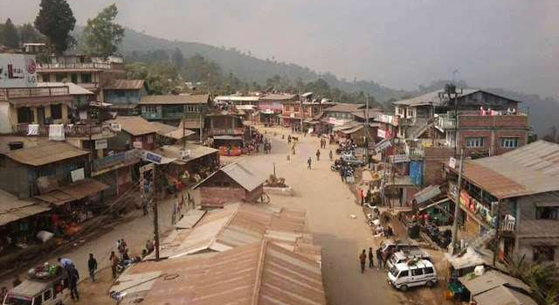
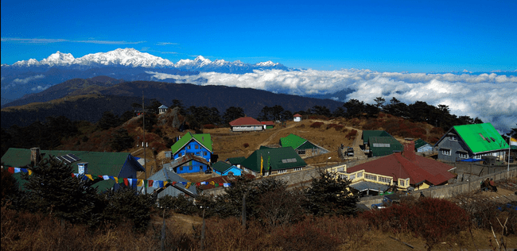
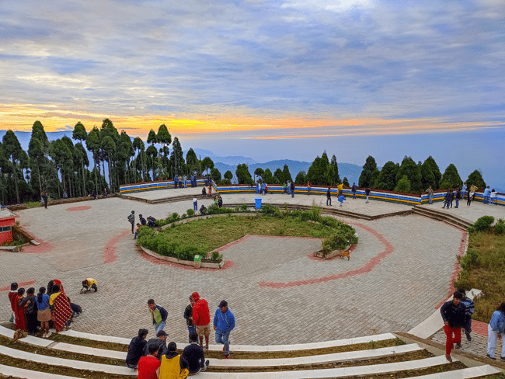
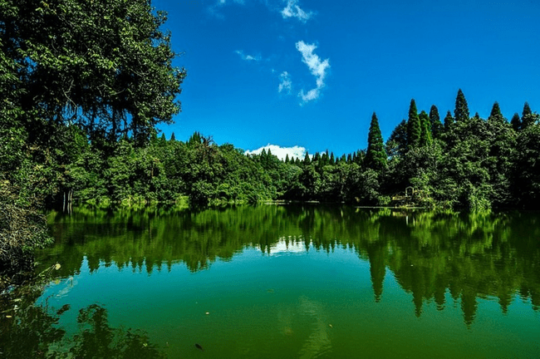
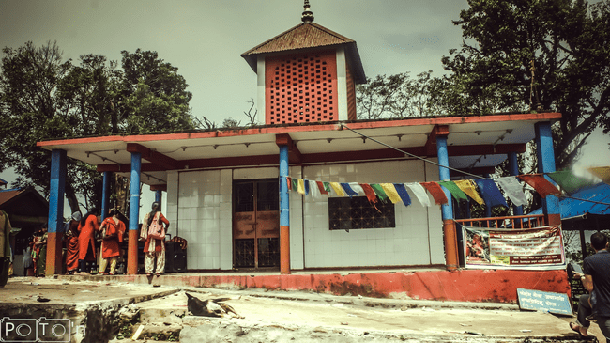
Kanyam
Phikkal
Sandakpur
Shree Antu
Mai Pokhari
Pathibhara Temple

Slide 13
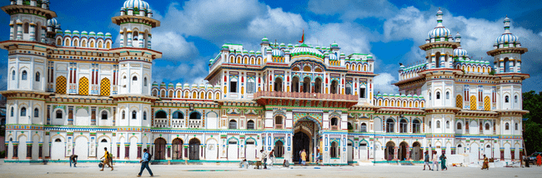
Janakpurdham: The Land Steeped with Mythology
Madesh Province
Terai Plain of Nepal
Birth Place of ideal woman Sita (Janaki)
City of Ponds

Slide 14
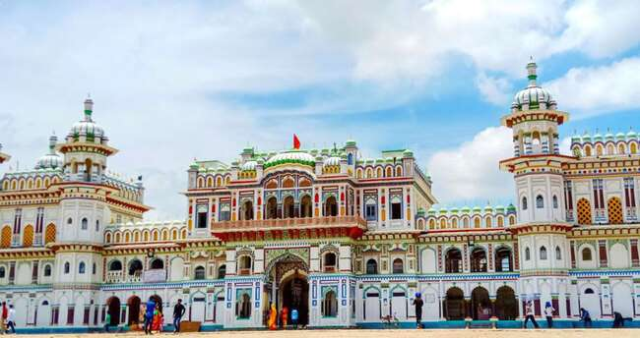
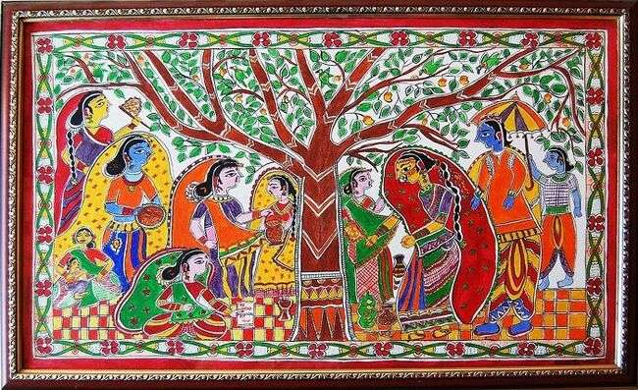
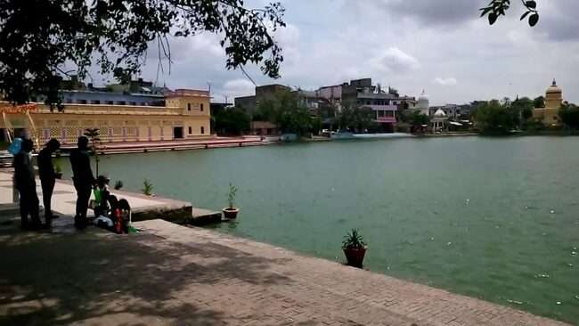
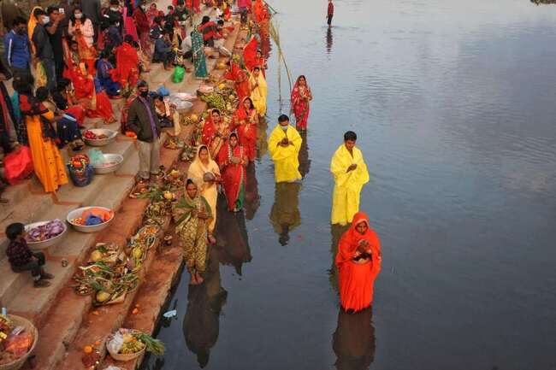
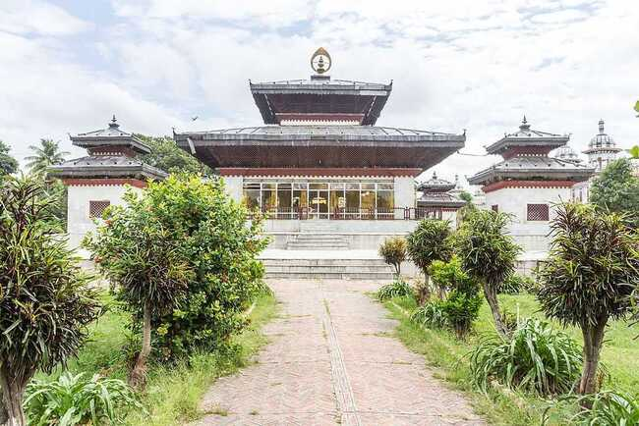
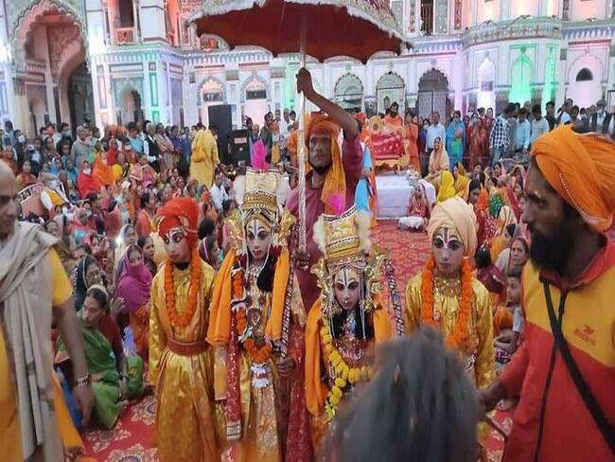
Janaki Temple
Mithila Painting
Sacred Pond
Chhath
Vivaha Mandap
Vibaha Panchami

Slide 15
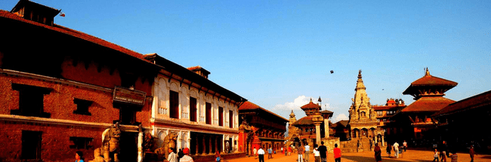
Bhaktapur: The City of Devotion
Bagmati Province
Bhadgaon, Khwopa (Newari Language)
Typical Cultural Newari Settlement
Pottery, wood carving, Newari culture, juju dhau

Slide 16
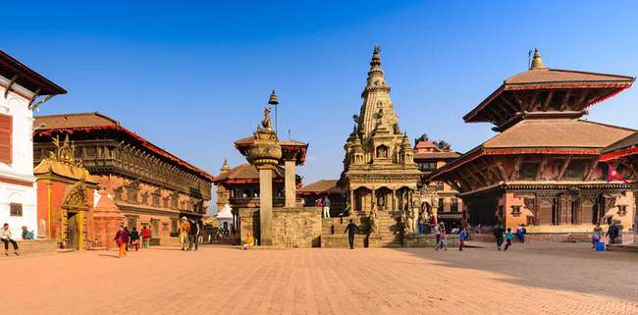
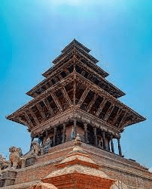
Bhaktapur Durbar Square
Changu Narayan Temple
Nyatapola
Nagarkot
Siddha Pokhari

Slide 17
Pokhara: The City of Mountains
Gandaki Province
Naturally beautiful
Lakes, mountains, sight seeing, trekking

Slide 18
Phewa Lake
Davi’s Falls
Gupteshwor Cave
Bindhyabasini Temple
World Peace Pagoda
Sarangkot

Slide 19
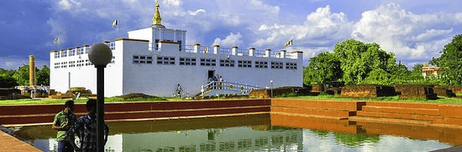
Lumbini: The Birth Place of Gautam Buddha
Lumbini Province
Religious and historical importance
Buddhism

Slide 20
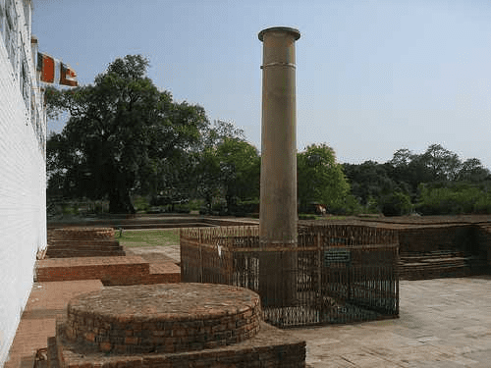
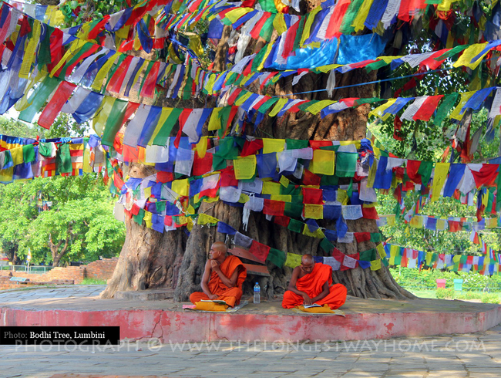
Ashoka Pillar
Mayadevi Temple
Bodhi Tree
Tilaurakot

Slide 21
Rara National Park
Karnali Province
Natural importance, Rara lake, Red panda
Mugu, Jumla

Slide 22
Rara Lake
Red Panda

Slide 23
Khaptad National Park
Sudur Paschim Province
Natural and religious importance
Natural Meuseum, Flora (herbs) and fauna, trekking

Slide 24
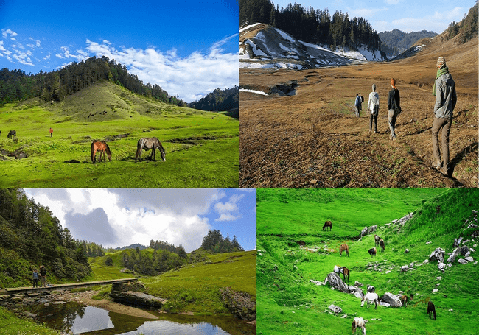
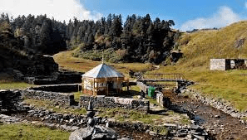
Flora, fauna, trekking
Khaptad Triveni Temple

Slide 25

Conclusion
The effects of covid-19 in these places – rapid decline in tourists flow
The improved scenario after covid-19 due to the responsible activities of local people, community and government
The necessity of responsible tourism to see more changing scenario in tourism
  Individual Local government
  Family Central government
  Community
Responsible
Tourism

Slide 26
Thank You

